Slide 1

Self-starting as a 3D graphics programmer
Nick Driscoll

Slide 2
Who am I?
Self-taught programmer since HS, DevOps engineer
Been studying realtime 3D graphics programming since my graduation from OSU’s computer science program in 2019
Developing a physically-based renderer in Rust using Vulkan
Wanted to give new programmers interested in low-level graphics programming a foundation for learning

Slide 3
Agenda
Define the technical problem of video game graphics
Intro to 3D graphics pipeline – high level algorithm
Detailed account of the three major pipeline stages
End with discussion of APIs, debugging tools, and how to learn more

Slide 4
Note
Disclaimer: No statements made here will be authoritative or 100% accurate in all cases
These slides will be available online after the talk
  No need to squint to read code samples
  All code samples are in GLSL

Slide 5
The task at hand
Video games display graphics on a screen
  2D grid of square pixels (1920x1080 for 1080p)
  Each pixel can be exactly one color at a time (represented as an RGB triplet)
  The current “screen“ being rendered to is called the "rendertarget" or "framebuffer"
The game must draw/render images by computing each pixel’s color value
Individual images produced by the game are typically referred to as frames

Slide 6
3D to 2D?​
We want to be able to render a frame given a description of a particular 3D scene
How do we represent 3D objects in a way that a computer can understand?
  3D object surfaces are made up of a bunch of triangles
    One list (array) of 3D vertex positions (Vertex buffer)
    One list (array) of triangle connectivity info (Index buffer)
    Together these buffers describe a list of triangles
We want an algorithm that can take triangle lists as input and produce colored on-screen pixels as output...

Slide 7
Enter: 3D graphics pipeline
The main algorithm that allows programs to render 3D objects is the 3D graphics pipeline
The pipeline accepts a list of triangles as input, and as output it writes colored pixels to a specified rendertarget
One run through of this pipeline is called a "draw call"
Much of the pipeline’s behavior is defined through configurable state, meaning some input data is defined in advance of the draw call

Slide 8
Enter: 3D graphics pipeline
Three major steps comprise the pipeline:
  1 - Vertex processing
    Vertex positions are transformed from 3D world space into 2D screen space, along with any other per-vertex work
  2 - Rasterization
    For each screen-space triangle, pixel coverage is determined
    Vertex attributes (I.E. position) are interpolated
  3 - Pixel processing
    Pixels covered by the triangle are assigned a color
    When a pixel has completed processing, it is written out to the rendertarget

Slide 9
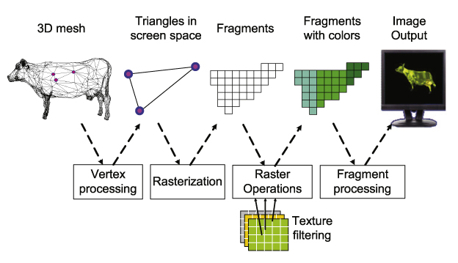
3D graphics pipeline illustration
Simplified 3D graphics pipeline

Slide 10
3D graphics pipeline: Conclusion
The previous steps are all there is to getting 3D objects rendered on a 2D screen
Everything in graphics is built on top of this foundation
Now we will revisit each step in more detail

Slide 11
3D graphics pipeline: The Second Pass
Three major steps comprise the pipeline:
  1 - Vertex processing
    Vertex positions are transformed from 3D world space into 2D screen space, along with any other per-vertex work
  2 - Rasterization
    For each screen-space triangle, pixel coverage is determined
    Vertex attributes (I.E. position) are interpolated
  3 - Pixel processing
    Pixels covered by the triangle are assigned a color
    When a pixel has completed processing, it is written out to the rendertarget

Slide 12
Vertex processing
For each vertex in a particular draw call, a GPU program called the vertex shader will be executed
The primary responsibility of the vertex shader is to take a vertex represented in 3D world-space and output its 2D screen-space position
The vertex shader is also responsible for any other per-vertex processing that you would like the GPU to do in a given draw call

Slide 13
Vertex processing cont.
“How exactly is a 3D world-space position transformed into a 2D screen-space position?”
I didn’t want this to become a math talk, but...
Oversimplified concepts from linear algebra:
  Vector: a point in a space
  Matrix: represents a transformation from one space to another
So, if you have a vector in space A, and you have a matrix that represents a transformation from space A to space B, then you can multiply the matrix with the vector to get the same vector in space B

Slide 14
Vertex processing cont.
Each object in the world will have at least one matrix that describes its position in the world
There will also be a matrix that represents the camera’s position in the world, as well as a matrix that describes how to project what the camera sees onto the screen
  Position
  Rotation
  Field-of-view

Slide 15
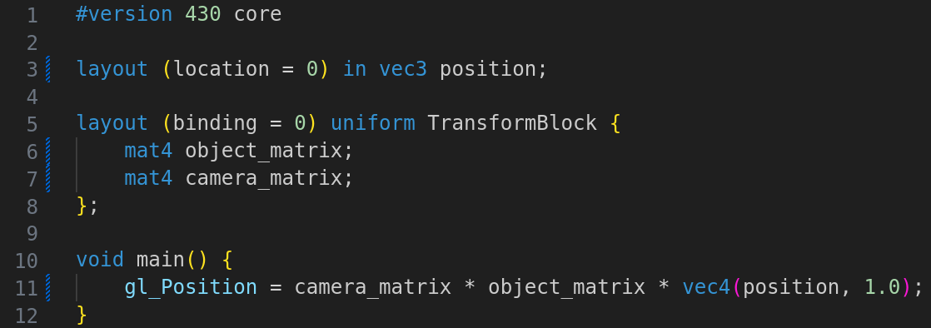
Vertex processing illustration
In the following code sample, the vertex shader multiplies an input vertex by the matrices that represent the transform from 3D space to screen space

Slide 16
3D graphics pipeline: The Second Pass
Three major steps comprise the pipeline:
  1 - Vertex processing
    Vertex positions are transformed from 3D world space into 2D screen space
  2 - Rasterization
    For each screen-space triangle, pixel coverage is determined
    Vertex attributes (I.E. position) are interpolated
  3 - Pixel processing
    Pixels covered by the triangle are assigned a color
    When a pixel has completed processing, it is written out to the rendertarget

Slide 17
Rasterization
After the transformation into screen space, the pixels that are covered by each triangle need to be determined via a process called rasterization
Lucky for us, the hardware does all of the work!
Instead of being fully programmable like the vertex and pixel stages, the rasterization step only has configurable attributes:
  Viewport/Scissor rectangles
  Polygon mode (I.E. wireframe or solid)
  Sampling rate (MSAA)
  Lots more

Slide 18
Rasterization: vertex attributes
One of the most important concepts regarding the rasterizer is the concept of vertex attribute interpolation
Each vertex will have associated with it some pieces of data, called vertex attributes
  3D position at minimum, but also any other desired data
“Interpolation” is simply a fancy word for smooth blending

Slide 19
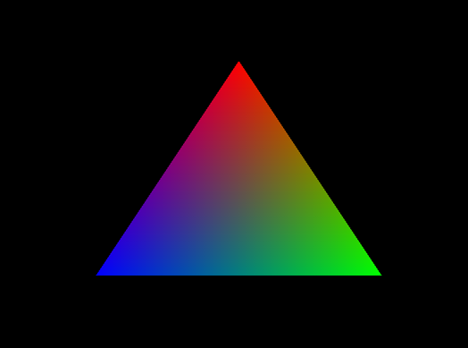
Rasterization example
Rasterized pixels will receive a value per vertex attribute that will be the linear interpolation of the three
Each vertex has been
assigned a solid color
Each pixel has been
assigned a color in
proportion to how close it
is to each vertex

Slide 20
3D graphics pipeline: The Second Pass
Three major steps comprise the pipeline:
  1 - Vertex processing
    Vertex positions are transformed from 3D world space into 2D screen space
  2 - Rasterization
    For each screen-space triangle, pixel coverage is determined
    Vertex attributes (I.E. position) are interpolated
  3 - Pixel processing
    Pixels covered by the triangle are assigned a color
    When a pixel has completed processing, it is written out to the rendertarget

Slide 21
Pixel processing
Each rasterized triangle will cover some number of pixels
For each of these pixels, the pixel shader’s code will be executed
The output of this shader will be the color of the pixel
This is where all logic related to lighting, textures, shadows, etc. happen

Slide 22
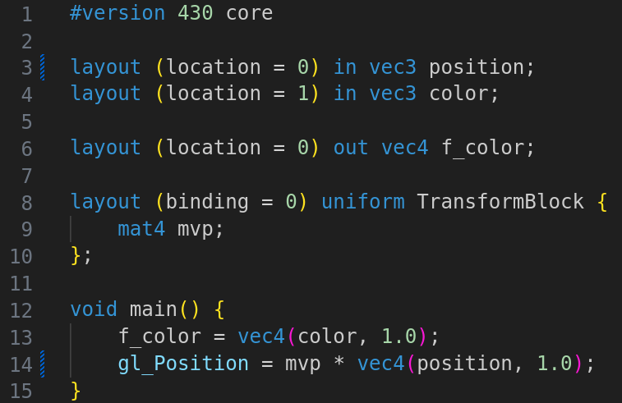
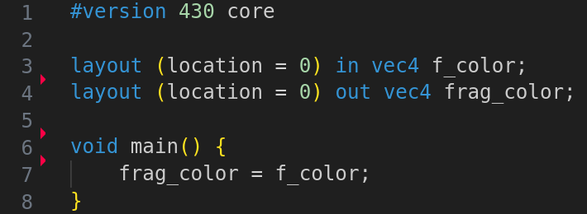
Pixel shader example
Pixel shader
Vertex shader

Slide 23
Actually building something
We just finished covering the main theory behind 3D graphics programming
How do we actually start writing code?
  GPU APIs
  Debugging tools
  Resources for getting started
  Presentations, papers, and the wider community

Slide 24
Graphics/GPU APIs
API – Application Programming Interface
  Composed of data structures and function definitions
APIs for programming graphics can be sorted into two major categories
  Graphics APIs – Older, designed specifically for graphics
    Direct3D 11 (and lower versions)
    OpenGL
    WebGL
  GPU APIs – Newer, designed for general control of the GPU
    Direct3D 12
    Vulkan
    Metal
    WebGPU

Slide 25
Graphics debugging tools
RenderDoc - Free MIT licensed graphics debugger that allows single-frame capture and detailed introspection of any application using most GPU APIs
Allows you to open any 3D graphics application and look at the API function calls it made during a particular frame
Invaluable for starting out

Slide 26
Vendor tools
GPU vendors have official tools that are more fully featured but are less intuitive to use
  NVIDIA Nsight
  AMD Radeon GPU Profiler
  Intel Graphics Frame Profiler

Slide 27
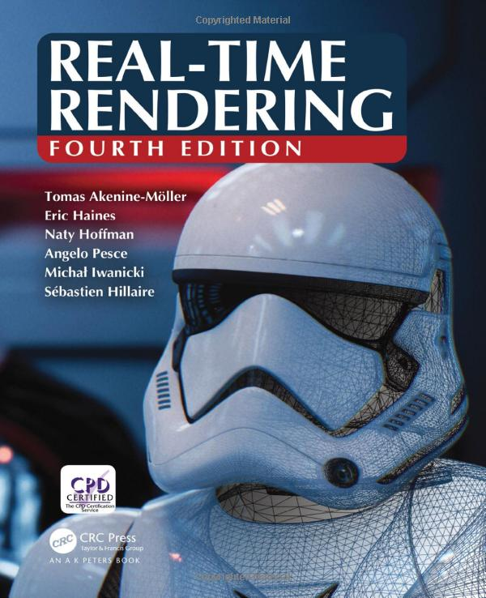
Resources for getting started
https://learnopengl.com
  Easy to digest, but can be inaccurate when going beyond the basics
Real-Time Rendering
Fourth Edition (2018)
  Broad survey of most realtime rendering
  techniques
  Lacks depth, but provides plenty of terms
  to go look up later

Slide 28
Papers? Please.
When you’re more intermediate and are looking to learn specific graphics techniques, one great place to look are the presentations and papers of graphics professionals
  SIGGRAPH
  ARXIV
  Graphics Programming Weekly by Jendrik Ilner

Slide 29

Discord
Graphics Programming discord
  https://discord.com/invite/udmRMSc
  Can find API specific discords from there as well
Reading the occasional conversation can teach you a ton

Slide 30
Code libraries
SDL2
  Window and event handling
  Widely used and broadly reliable
GLM
  Linear algebra library
  Allows you to get away with understanding even less math
Dear ImGUI
  Simple in-app UI panels
  GOAT

Slide 31
Words of wisdom...
Start small
Don’t fear the feeling of stupidity
Community is everything

Slide 32


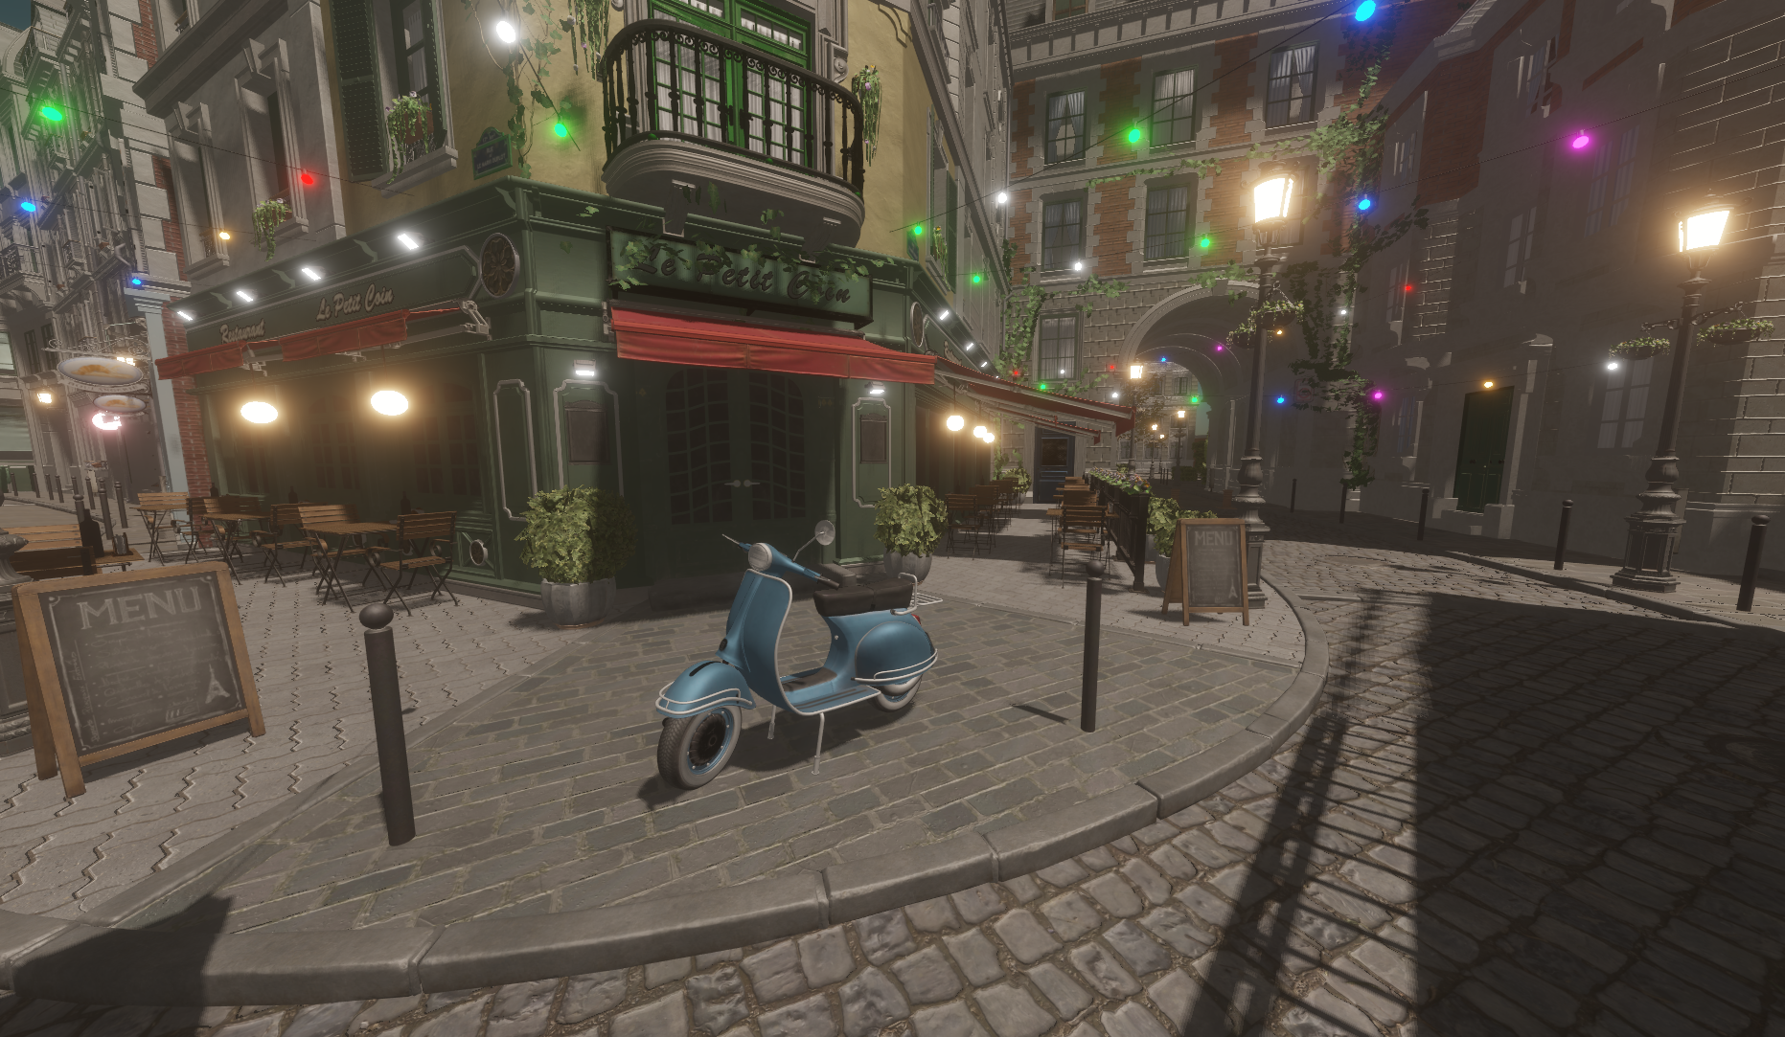


Q&A
Follow me on Mastodon:
My website:
Link to slides:

